Slide 1
A nationwide effort is underway to remove Confederate statues and symbols from government grounds across America. In dozens of cities across the U.S., activists are vandalizing and toppling Confederate monuments and symbols. They’re also pushing for cities, counties and states to destroy or relocate statues dating back more than a hundred years.

Slide 2
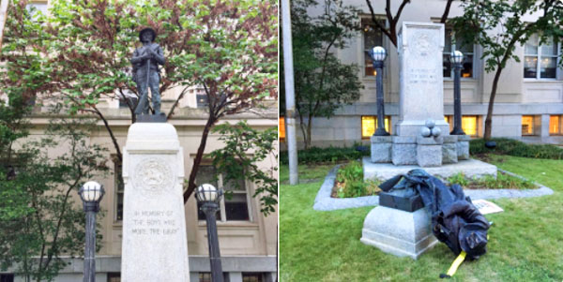
Durham, North Carolina: Main Street soldier

Slide 3
Groups involved included the Workers World Party, Industrial Workers of the World, Democratic Socialists of America, and Antifa, according to the Herald Sun. The statue, called the Main Street soldier, was dedicated in 1924 and bears the inscription “In memory of the boys who wore the gray.”
Sheriff’s deputies reportedly recorded the entire event, but did nothing to stop it. The vandals began to kick and punch the statue, which broke into pieces after it slammed into the ground. Demonstrators then marched down the street, under the protection of police, who allowed them to block traffic. Durnham County authorities hardly even denounced the action, and only gave a lukewarm statement:
Durham Police Department (DPD) officers monitored the protests that occurred in the city tonight to ensure the protests were conducted in a safe manner and that no infractions occurred within city jurisdiction,” police said in a statement.

Slide 4

Woman who helped bring down a Confederate monument in Durham, North Carolina

Slide 5
Paul Nehlen, Republican candidate for Congress challenging House Speaker Paul Ryan in Wisconsin’s 1st district, tweeted that these actions are “never about the monuments. It was always about shutting you up, and forcing your compliance.”
Chicago, Illinois: George Washington and Andrew Jackson
A Chicago pastor is calling on Mayor Rahm Emanuel to remove the names of two slave-owning U.S. presidents from parks in the city.
A bronze statue of President George Washington on horseback stands at the corner of 51st and King Drive, at the northwest entrance to Washington Park. A monument honoring President Andrew Jackson stands nearby in Jackson Park.
Bishop James Dukes, pastor of Liberation Christian Center, suggests renaming Washington Park after former Mayor Harold Washington, and Jackson Park could be renamed after Rev. Jesse Jackson or singer Michael Jackson.

Slide 6
Hollywood, California: Confederate memorial at the Hollywood Forever Cemetery
The Hollywood Forever Cemetery removed a 6-foot monument commemorating Confederate veterans that has stood in the Confederate section of the cemetery since 1925. More than 30 Confederate veterans, along with their families, are buried there.

Slide 7
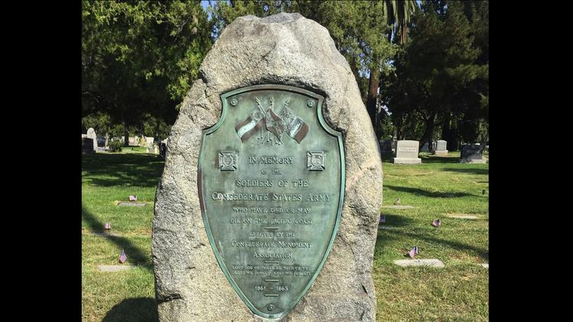

Slide 8

Baltimore, Maryland: Four monuments linked to Confederacy
Confederate statues in Baltimore were removed from their bases overnight by city contractors, who used heavy machinery to load them onto flat bed trucks and haul them away.
The Baltimore City Council unanimously passed a resolution calling for the immediate deconstruction of four monuments in the city.
Mayor Catherine Pugh, who made the decision, watched in person as the four statues linked to the Confederacy were torn from their pedestals.

Slide 9
Asheville, North Carolina: Vance Monument
There are growing calls to remove a 75-foot granite obelisk in Pack Square known as the Vance Monument in Asheville, North Carolina.
The monument, which was erected in 1896, is a tribute to Zebulon Vance, a Civil War governor of North Carolina and a U.S. senator during the Reconstruction period.

Slide 10
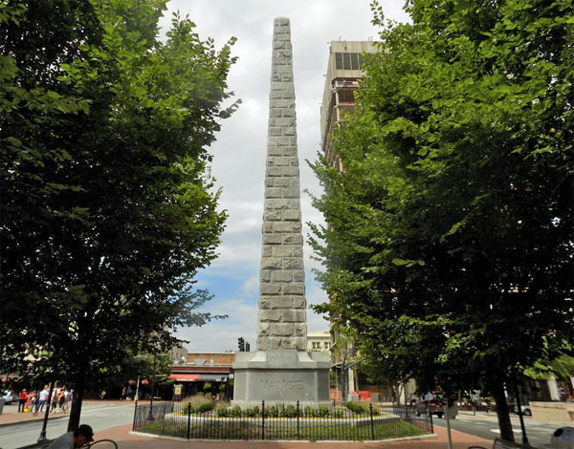

Slide 11
Chapel Hill, North Carolina: ‘Silent Sam’
Another memorial targeted for removal is the 1913 “Silent Sam” statue at the University of North Carolina at Chapel Hill. The $7,500 for the monument was funded by UNC alumni and the United Daughters of the Confederacy.

Slide 12
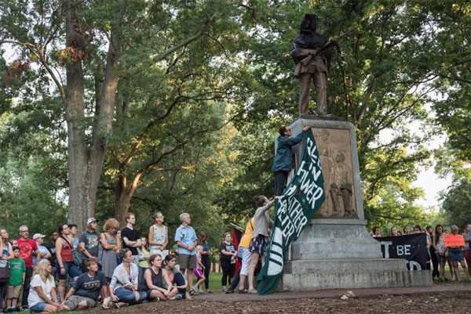
In 2015, the monument was spray-painted with “Black Lives Matter,” “KKK” and “murderer.”

Slide 13
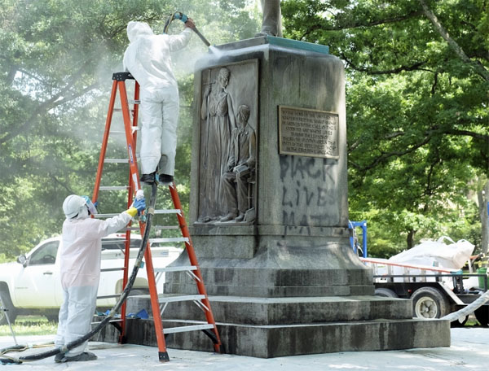

Slide 14
Greenville, North Carolina: Confederate Soldiers statue
Residents in Greenville, North Carolina, are circulating a petition demanding removal of the Confederate Soldiers statue at the Pitt County Courthouse.
The monument, which was dedicated in 1914, states, “Erected by the people of Pitt County in grateful remembrance of the courage & fortitude of her Confederate Soldiers.”
The petition calling for its removal says: “We, the residents of Greenville, submit that the time has come for the removal of the Confederate statue at the courthouse. It is time to take immediate action to remove this monument to slavery, sedition and racial oppression. Additionally, it is our assertion that this statue subverts and undermines our core principles

Slide 15
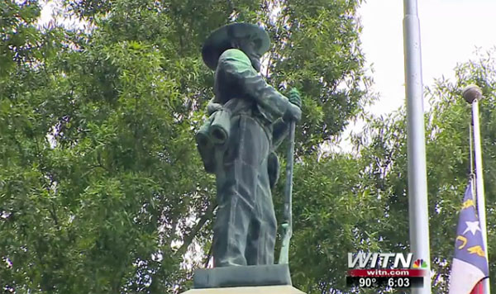

Slide 16
Nashville, Tennessee: Confederate Gen. Nathan Bedford Forrest
In Nashville Monday, protesters called for removal of a bust of Confederate Gen. Nathan Bedford Forrest at the state capitol.
Protesters chanted “White silence is violence,” “Which side are you on?” and “Tear it down.”

Slide 17
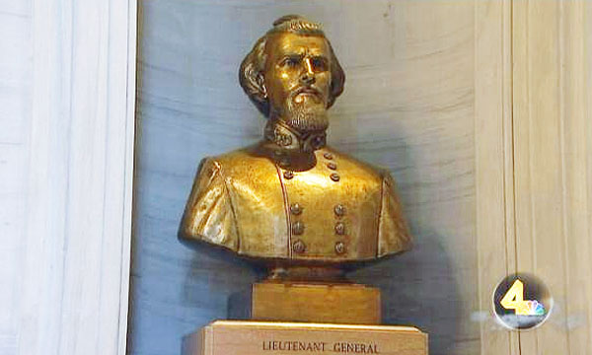

Slide 18
Memphis, Tennessee: Nathan Bedford Forrest and Jefferson Davis
The city of Memphis is threatening to sue Tennessee to remove two Confederate states from city property, according to Fox News. The city must get approval from the Tennessee Historical Commission.
The city is seeking to remove statues of Nathan Bedford Forrest and Jefferson Davis. And the legal battle could go to the Tennessee Supreme Court.
“I think one thing that is for sure, there is no place in the city of Memphis for signs or symbols of hatred, bigotry or racism,” said City Council Chairman Berlin Boyd.

Slide 19
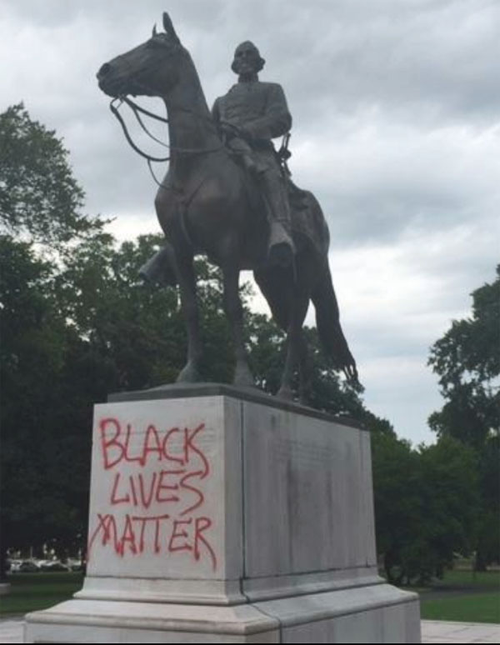
Memphis Mayor Jim Strickland said in a statement: “It’s great to see more citizens join the cause we’ve been working on for years. We continue to be actively engaged in exploring all avenues to remove the Confederate statues in our city.”
The Sons of Confederate Veterans issued the following statement, according to Fox: “The city of Memphis should in no way want to remove statues and monuments to our history. These monuments are part of our development and both Jefferson Davis and Bedford Forrest were U.S. Army veterans as well as leaders in the Confederate States. Both lived in Memphis and contributed to its rebuilding and renewal after the War for Southern Independence. The city of Memphis should not play the part of ISIS historical terrorists in attempting to remove our historical monuments. Such actions are an insult to the families and citizens – and all veterans – of our city, county, state, and country. Leave the monuments and leave history alone.”

Slide 20
Chattanooga, Tennessee: Lt. Gen. Alexander P. Stewart
In Chattanooga, Tennessee, a statue of Confederate Lt. Gen. Alexander P. Stewart has been in the crosshairs of activists demanding its removal.
The local chapter of the NAACP has called for it to be taken down. “We find it offensive to be reminded constantly of the atrocities that they represent,”

Slide 21
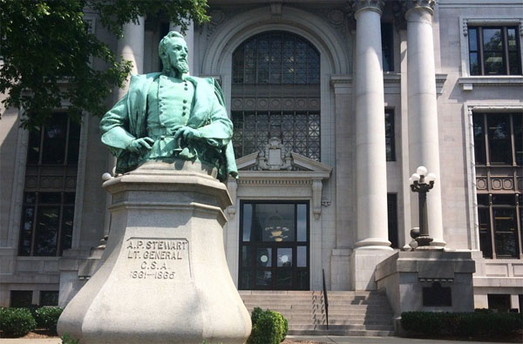

Slide 22
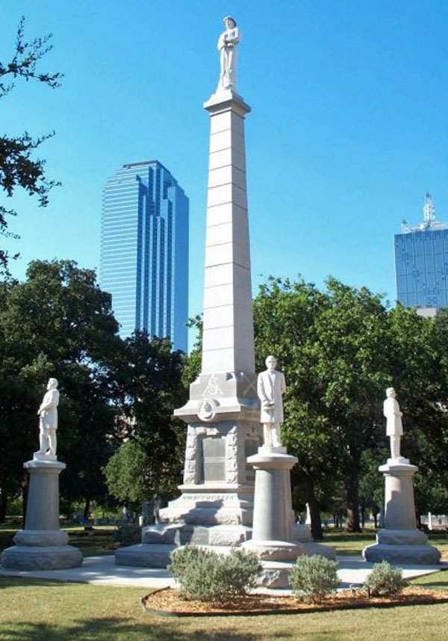
Dallas, Texas: Gen. Robert E. Lee & Founders Cemetery Monument
Dallas, Texas Mayor Mike Rawlings has called for a task force to review removal options for Confederate statues in the city.
The monuments are located in a historic cemetery near the Dallas Convention Center and in Robert E. Lee Park.

Slide 23
San Antonio, Texas: Confederate soldier statue
Approximately 500 protesters attended a vigil for Charlottesville in San Antonio’s Travis Park on Aug, 13, and a monument for a Confederate soldier there was a subject of the rally,
“This is not an important art piece but a monument to power,” Trevino said. “It was put in to remind people of that power. It is an unfortunate message of hate, and we think it’s important to relocate it. We do think that history is important, so we’re looking for an appropriate location for it.”

Slide 24
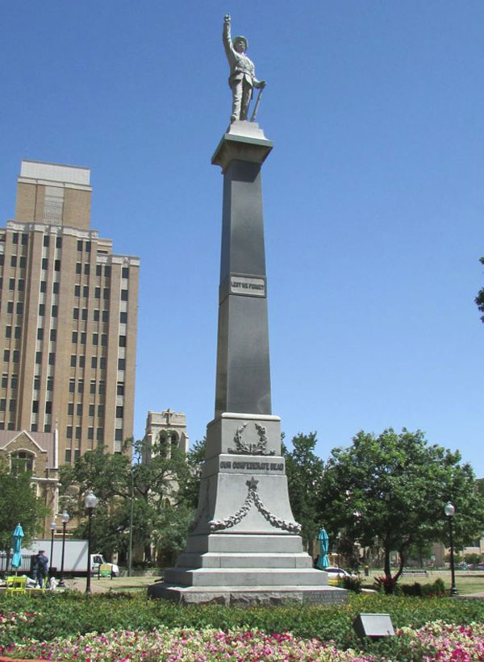

Slide 25
Tampa, Florida: ‘Memoria In Aeterna’
Members of the Sons of Confederate Veterans are standing guard by a Confederate monument on the grounds of the historic county courthouse in Tampa, Florida, the Tampa Bay Times reported.
The Sons of Confederate Veterans learned that leftist activists had plans to topple the marble statue, known as “Memoria In Aeterna,” which depicts a Confederate soldier heading to war and another soldier returning home wearing a ragged uniform. On Aug. 13, 200 protesters marched through the streets in Tampa, and several climbed the monument.
The Hillsborough County Commission has already voted to move the statue off courthouse grounds and to a local cemetery

Slide 26
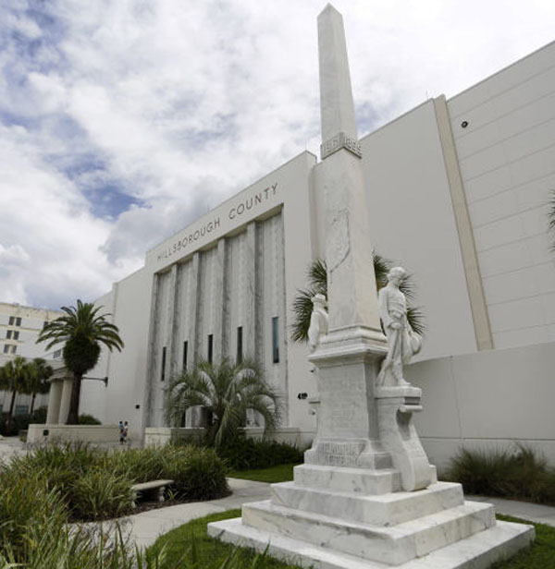

Slide 27
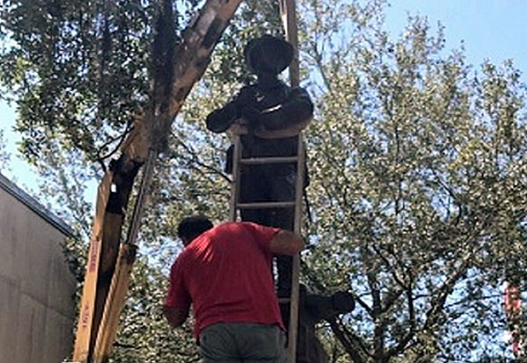
The bronze monument constructed and erected in 1904.
Gainesville, Florida: ‘Old Joe’
In Gainesville, Florida, crews removed a Confederate memorial on Aug. 14 that had been dedicated to men in the area who served in the Civil War and lost their lives fighting.

Slide 28
Baltimore, Maryland: Jackson-Lee Monument
On Aug. 13, protesters called on Baltimore city leaders to remove the Jackson-Lee Monument, a Confederate symbol, at Wyman Dell Park near Johns Hopkins University.
The activists erected their own statue in front of the Jackson-Lee Monument. It depicted a pregnant black woman with her fist in the air and a child on her back, the Baltimore Sun reported.
A passerby pushed the protesters’ statue over. A photo posted to Twitter Tuesday by “Baltimore BLOC” showed the Jackson-Lee Monument with “Black Lives Matter” and “Remember C-Ville” (Remember Charlottesville) spray-painted on the sides.

Slide 29
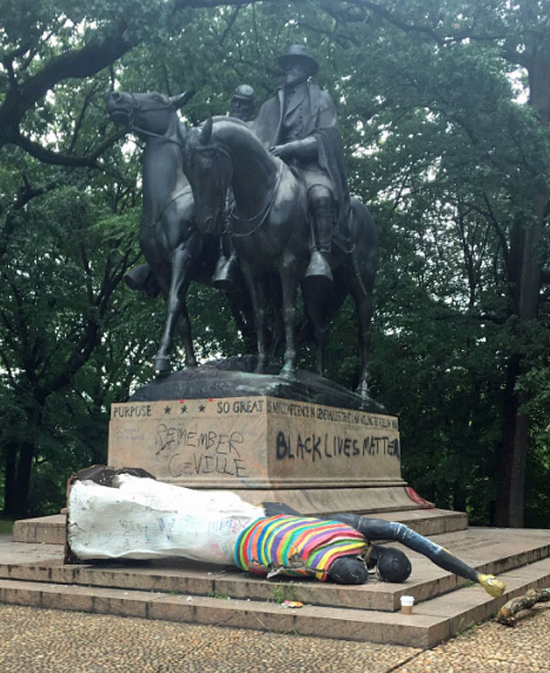

Slide 30
Ellicott City, Maryland: Stone honoring 92 Confederate soldiers
A Confederate monument dedicated in 1948 and bearing the names of 92 soldiers may be removed from outside Howard County’s Circuit Court building in Ellicott City, Maryland.
“We need to put that sort of history into context and understand it but not revere it,” Weinstein said. “It is a monument. It is a representation of the fact that people in Ellicott City served in the Confederate army. We don’t have to be proud of that fact, but it is a fact.”
Councilman Calvin Ball said he prefers to see the monument moved immediately.
“The environment that we create going towards the halls of justice should be one of freedom, equality and fairness,” he said. “And monuments to the Confederacy do not convey that.”

Slide 31
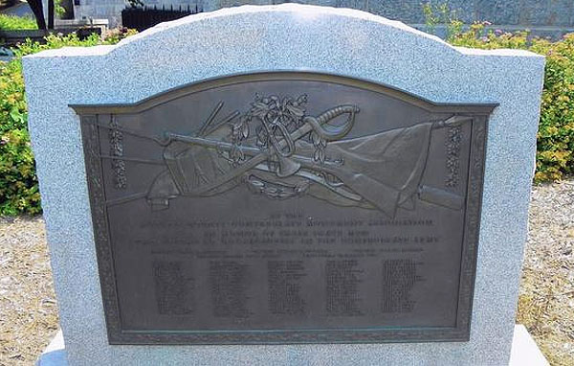

Slide 32
Rockville, Maryland: Confederate Soldier Statue
Officials in Montgomery County, Maryland, ordered a 13-ton bronze Confederate soldier statue removed from the grounds of Rockville’s Red Brick Courthouse. The memorial depicts a young soldier with his arms folded and a saber at his side.
The statue’s plaque states: “To Our Heroes of Montgomery Co., Maryland, That We Through Life May Not Forget To Love The Thin Gray Line.”

Slide 33
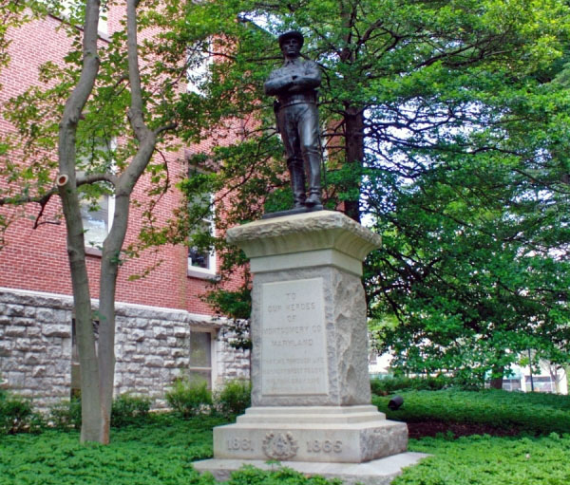

Slide 34
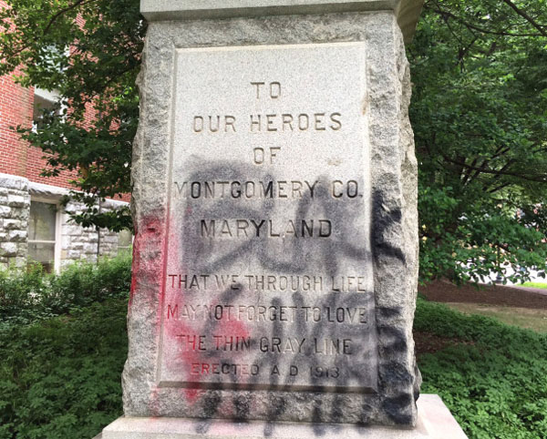
The county encased the statue in a wooden box after that incident. Earlier this year, it was moved to private property at White’s Ferry in Dickerson

Slide 35
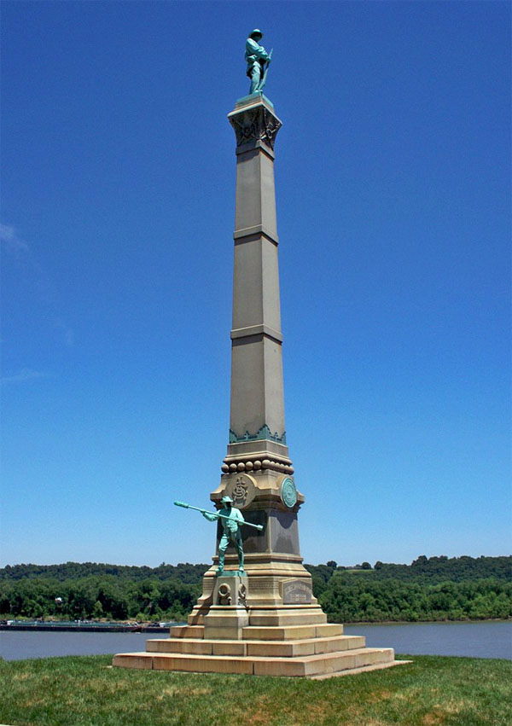
Louisville, Kentucky: Confederate Monument to Civil War Soldiers
A 70-foot-tall granite and bronze Confederate monument at the University of Louisville in Louisville, Kentucky, was removed in 2016 by the college.
That statue was erected in 1895 by the Kentucky Women’s Confederate Monument Association to honor Confederate soldiers who died during the Civil War.
“The school said it was an unwelcome symbol of slavery.”

Slide 36
Birmingham, Alabama: Confederate Soldiers and Sailors Monument
The mayor of Birmingham, Alabama, William Bell, has ordered that a Confederate Soldiers and Sailors monument be covered in plastic while the city examines its legal options for removal.
The 35-foot monument, which was gifted to the city in 1905 by the United Daughters of the Confederacy, is located in Linn Park. Linn Park is named after Confederate Capt. Charles Linn, whose name appears on many of the city’s buildings.

Slide 37
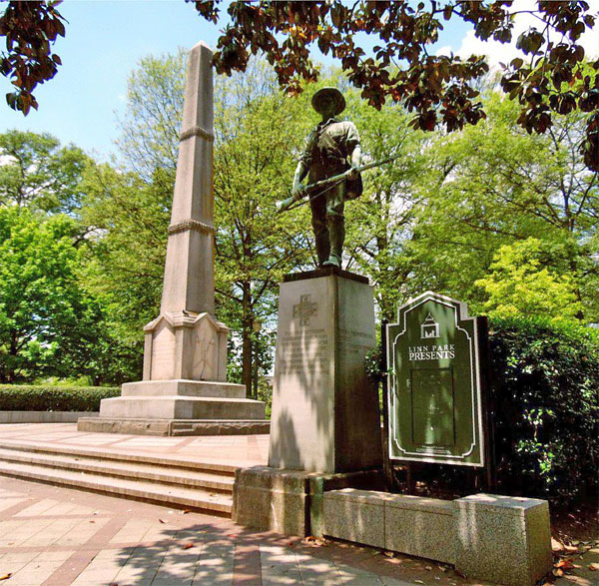
In 2015, the city voted to look into removal of the statue after the murder of nine black church attendees at the hands of shooter Dylann Roof.

Slide 38
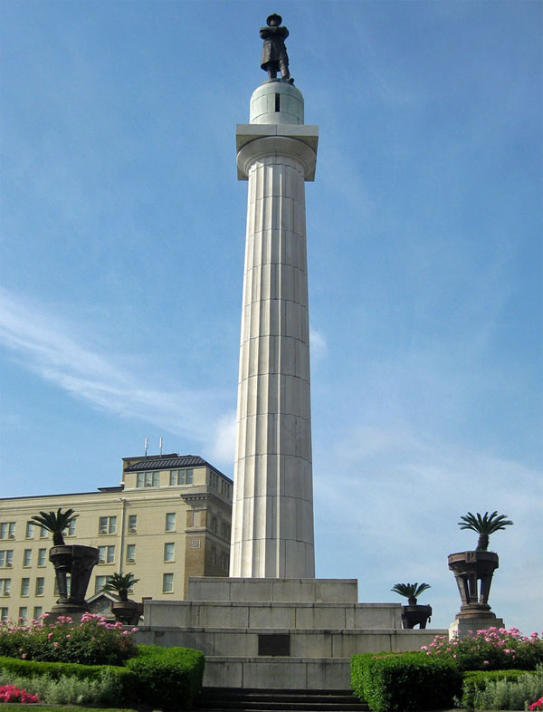
New Orleans, Louisiana: Gen. Robert E. Lee, Jefferson Davis & Gen. P.G.T. Beauregard
Four Confederate monuments have been removed in New Orleans and stored in a warehouse.

Slide 39
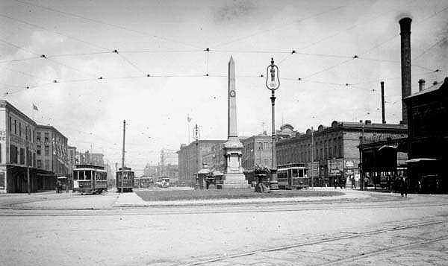
The last, a 20-foot bronze statue of Confederate Gen. Robert E. Lee, was removed in May 2017. The “Battle of Liberty Place” monument in New Orleans in 1906

Slide 40
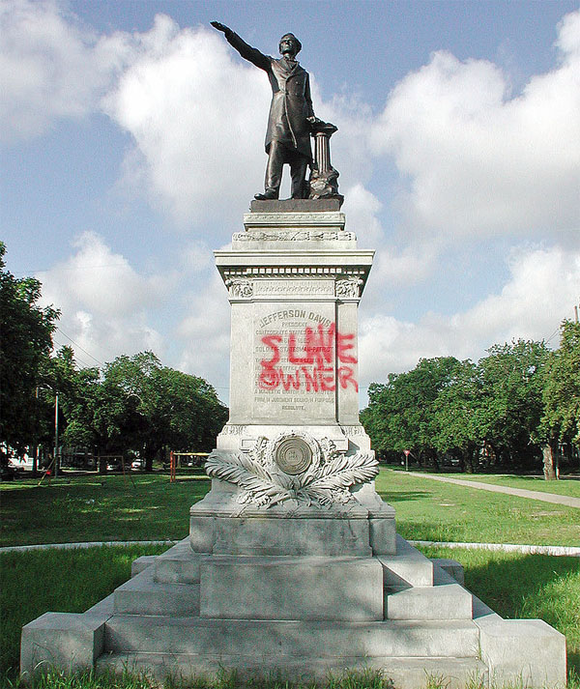
Landrieu has said the monuments do not represent New Orleans.
“These statues are not just stone and metal,” he said, according to the New York Post. “They are not just remembrances of a benign history. These monuments celebrate a fictional, sanitized Confederacy; ignoring the death, ignoring the enslavement, ignoring the terror that it actually stood for.
“After the Civil War, these statues were part of that terrorism, such as burning a cross on someone’s lawn. They were erected purposefully to send a strong message to all who walked in their shadows about who was still in charge of this city.”

Slide 41
Shreveport, Louisiana: Caddo Parish Confederate Monument
There’s now a movement in Shreveport, Louisiana, to remove a Confederate monument on courthouse grounds. The Caddo Parish Confederate Monument features busts of four Confederate generals – Gens. Henry Watkins Allen, P.G.T. Beauregard, Robert E. Lee and Stonewall Jackson – and a statue of a soldier. It was dedicated in 1906 and marks the location where the Confederate flag was lowered on land.
“It is time to take immediate action to remove this monument to slavery, sedition and racial oppression. Additionally, it is our assertion that this statue subverts and undermines our core principles of liberty and justice for all. It is unconscionable that anyone going to the courthouse, a place promising equal justice for all, should be forced to do so under a shadow of injustice and oppression.”

Slide 42
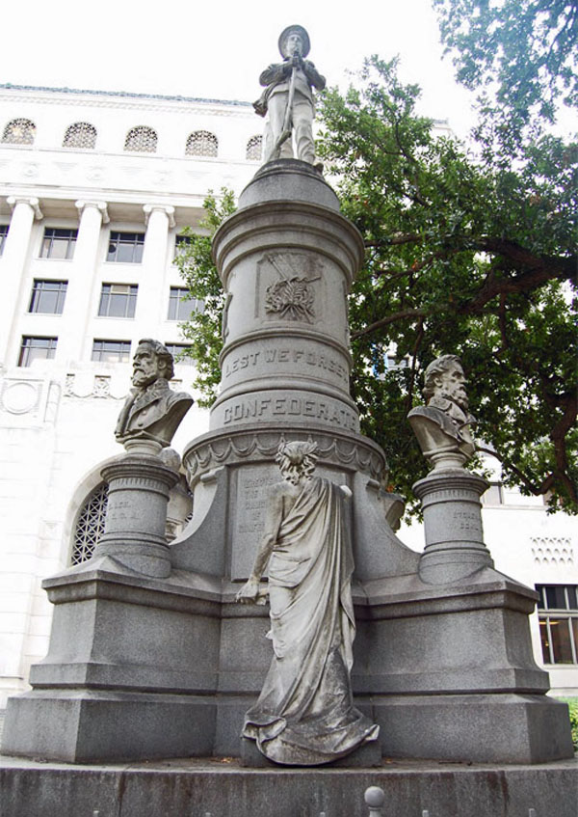

Slide 43
St. Louis, Missouri: Confederate Memorial is Removed
In June, St. Louis, Missouri, officials removed a 32-foot granite and bronze Confederate memorial in Forest Park. The Missouri Civil War Museum paid for the relocation and will store it until a new location is found for the statue at a museum, battlefield or cemetery.
“We wanted it down,” said St. Louis Mayor Lyda Krewson during a livestreamed news conference in June.
The memorial, which was located on Confederate Drive, was dedicated in December 1914 by the Ladies Confederate Monument Association.

Slide 44
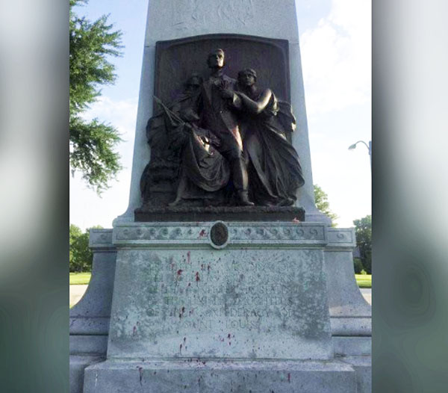
It features “The Angel of the Spirit of the Confederacy” over a family sending a soldier to war.
Reuters reported that the memorial had been repeated- ly spray-painted with “Black Lives Matter” and “End Racism.”

Slide 45
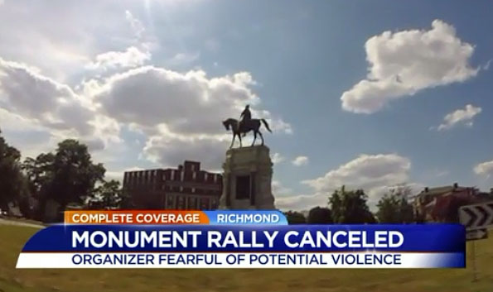
Richmond, Virginia: Confederate Statues Lining Monument Avenue

Slide 46
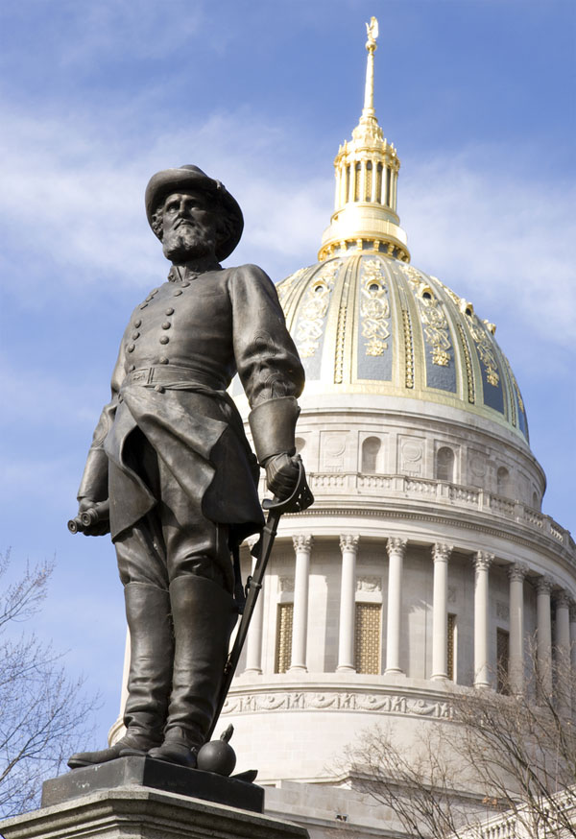
Charleston, West Virginia:
Stonewall Jackson
At least 150 people in Charleston, West Virginia, called for removal of a statue of Confederate Gen. Stonewall Jackson on the grounds of the state capitol on Aug. 13.
The crowd urged West Virginia Gov. Jim Justice to take it down.

Slide 47
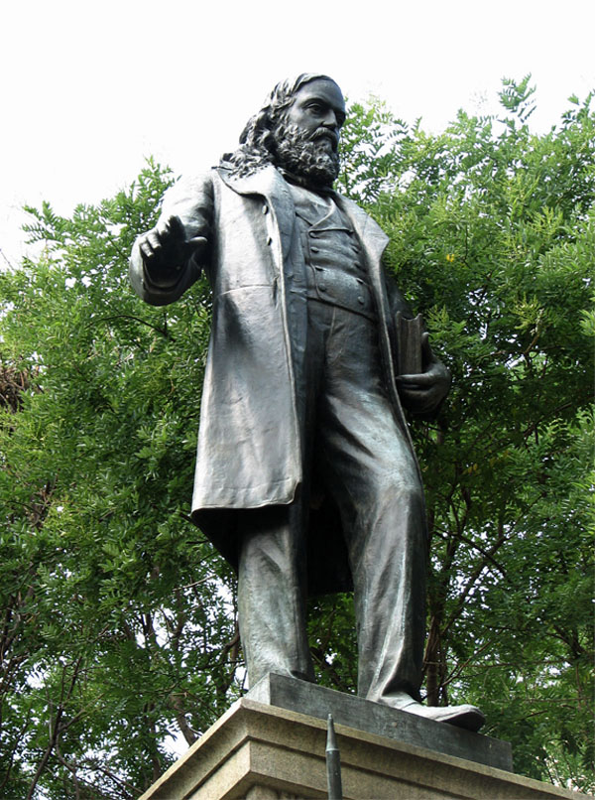
Washington, D.C.: Gen. Albert Pike
At least 1,000 protesters gathered outside the White House this week and then marched to a 1901 statue of Confederate Gen. Albert Pike, which is located near the D.C. Metropolitan Police Department headquarters.
The crowd booed and chanted “tear it down” in front of the statue. Some protesters climbed the statue.
On Monday, more protesters marched to the site with signs that said, “White Supremacy is Terrorism” and “Black Lives Matter.”

Slide 48
CONSIDER THE FOLLOWING:
The reason why our historical monuments are coming down is because historically ignorant people believe the lie that the South was an evil empire that fought the North in order to preserve slavery.
If the Confederacy fought to preserve slavery, why isn’t slavery mentioned on any of these monuments?
Who would believe that Confederate soldiers (which 80% of them never owned slaves) would suffer four years of the horrors of war so rich men could keep their slaves?
Why did the hundreds of millions of people in America over the last hundred years not have a problem with our Confederate monuments? Were they all racists?
But some still say that slavery is a horrible sin and the Confederates were evil because they refused to free their slaves. Let’s look at a few facts in order to get a clear biblical perspective.

Slide 49
Slavery has existed in probably every nation in the world ever since there was a nation.
Is it prudent or fair to judge bygone nations and societies by current laws and societal standards?
Does the Bible condemn slavery as a sin or does it consider it an undesirable institution that exists as part of a fallen word .
Did God give the Israelites instructions regarding slavery so they would treat their slaves in a humane and just manner?
Our righteous God must condemn sin, He can have no association with it. If slavery was a horrible sin, wouldn’t God condemn it rather than regulate it?
Abuse of slaves is a sin just as husband’s abuse of their wives is a sin and of course the Bible condemns both.
The fact that some slave owners abused their slaves did not
make slavery a sin any more than a husband abusing his
wife makes marriage a sin.

Slide 50
1 Corinthians 7:20-21 Let each man remain in that condition in which he was called. 21) Were you called while a slave? Do not worry about it; but if you are able also to become free, rather do that. 22) For he who was called in the Lord while a slave, is the Lord's freedman; likewise he who was called while free, is Christ's slave.
Of course being Christ’s slave is an honor because He is
the perfect Master, but would Paul use the term “Christ’s
slave” if slavery was a detestable sin?
Philemon was a Christian who owned a slave but he received no rebuke from the Apostle Paul for doing so.
In fact, Philemon’s slave ran away and Paul persuaded
him to return to his master.
This is not to suggest that Paul approved of slavery, but
recognized that it is part of the human experience in
which we must live and was also how many in the
Confederacy viewed slavery as well.

Slide 51
The Bible speaks of slaves who would voluntarily remain as
slaves even when they had the opportunity to be free (Ex. 21:5-6 & Deut. 15:16-17). This existed in the South as well. If slavery was the abominable scourge that it is portrayed to be today, why did some slaves refuse to be free when they had the opportunity?
Many associate the KKK and White Supremacists, who are racists, with the Confederacy because they often display the Confederate flag. That no more makes the Confederacy racist than me wearing an Astro’s hat makes me a player on the Astros baseball team.
None of this is to present slavery as something that was desirable or to minimize the suffering of slaves who were abused by their masters. These facts were given to put slavery and the South in their proper perspective and to counter the emotional hysteria that is behind the movement to take away our historical monuments in order to satisfy politically correct progressives. They will never be satisfied until every one adopts their immoral, unconstitutional, and unbiblical views.

